Slide 1


Slide 2

SENOAMADI TJ – AI ENG
LETSIE TR – ELECTRONICS ENG
NAKANA SS – CAD & IoT

Slide 3

Emergency disappears into a phone call. No resource view.

Slide 4
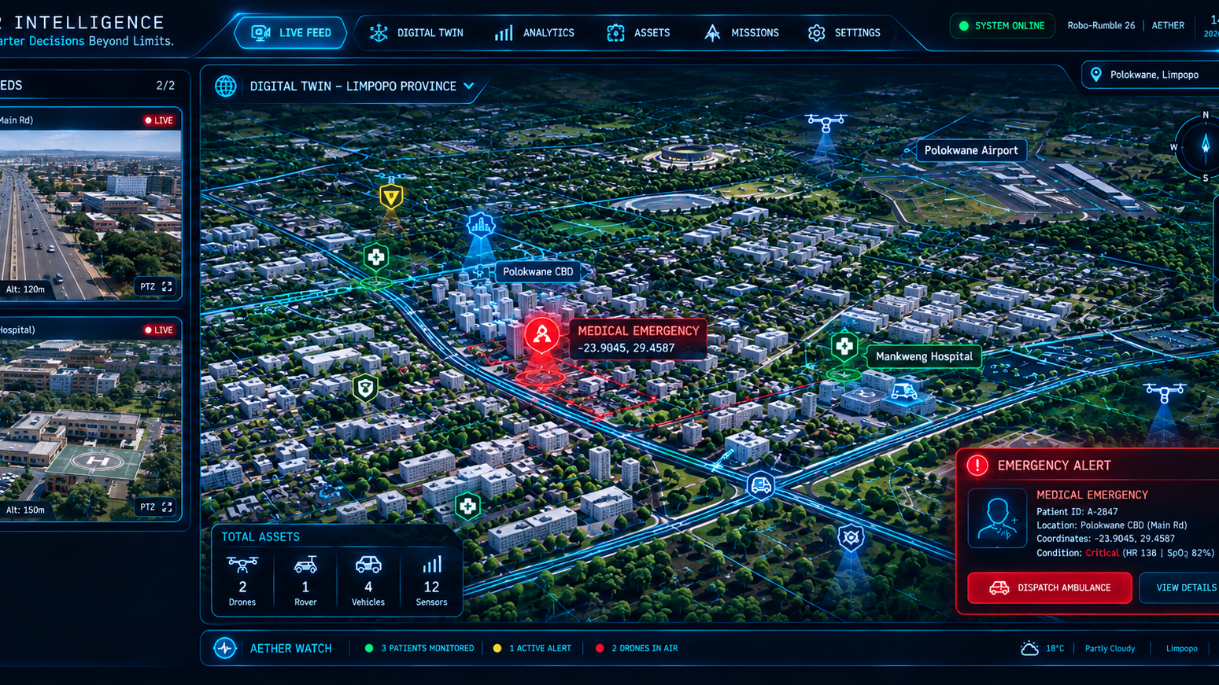
SOLUTION

Slide 5
Business Model
Who benefits?
Limpopo residents, students, People Living Alone.
Who pays?
University / SAPS Community (NOT the victim)
Pricing
Wearable: R1 200 estimated cost | R2 200 selling price
Drone: R4 000 estimated cost | R8 000 selling price
Monitoring: R150 per user per month
Pilot: 100 users = R220k + R15k/month monitoring
Scale: 1 500 users = R3.3M + R2.7M/year recurring
Why they buy:
Improve emergency visibility and coordination, and cut response time from 40min to 10min. One failed response costs them millions.

Slide 6

Thank you.

